Slide 1

Open Peer Review 30 Sept 2019

Slide 2
JDI Open
Bi-weekly seminars on (the implementation of) open science practices
20-30 minutes followed by discussion
@JDI_Open & jdiopen.github.io

Slide 3
Open Science
… practices and activities that make scientific endeavours more transparent and inclusive by increasing the availability of information that allows others to evaluate and use the research

Slide 4
Open Science Advantages
encouraging collaboration
promoting appropriate allocation of credit to researchers
enabling scientists to more easily build on prior work
supporting meta-science
facilitating theory development
increasing the return on investment from grant funding

Slide 5
Previous | Coming up
Pillars of open science How to: pre-registration Open Science for your career Sharing code and data Open access publishing (UCL libraries) P-values and power Open education Responsible use of bibliometrics (UCL libraries) Doing meta-science Crowd-sourcing science Sharing (sensitive) data Registered reports | 14/10 Responsible use of p-values 28/10 Bibliometrics and the DORA declaration 11/11 Writing replicable methods 25/11 Introduction to Bayesian statistics 9/12 Sharing sensitive data

Slide 6
Someone who hasn’t received a review | Someone who has never reviewed
Someone who has received review(s) | Someone who has reviewed paper(s)

Slide 7
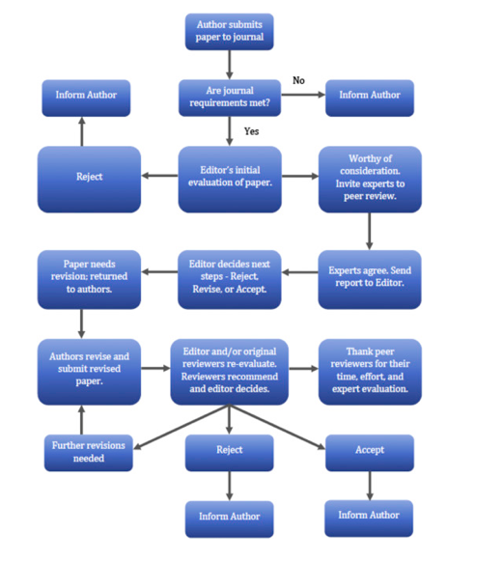
The Idea Behind Peer Review
Elsevier:
“The peer review system exists to validate academic work, helps to improve the quality of published research, and increases networking possibilities within research communities. Despite criticisms, peer review is still the only widely accepted method for research validation and has continued successfully with relatively minor changes for some 350 years.”

Slide 8
What Peer Reviews Can Look Like

Slide 9
What Peer Reviews Can Look Like
I note that the title of the journal is ‘Perspectives on Terrorism’ so literally this piece qualifies. My background does not have a monopoly on how to conduct terrorism research but typical of quantitative methodology, for me, there is an overemphasis here on methodology, method and results. I am biased against quantitative methodology so may not be sufficiently impartial to render an objective view of the piece. But the bottom line is, I think it is far too narrow in focus to appeal to a multi-disciplinary terrorism readership and I wouldn’t willingly read the piece in print, I’m sorry.
… But mostly it is really useful and improves the manuscript!

Slide 10
What Peer Reviews Can Look Like
As a final note, I want to again laud the authors for being transparent with their data, code, and general reporting. I am extremely critical of the methods and conclusions, but I would not have been able to examine this work as closely if the authors had not been so transparent. Ultimately, facilitating scrutiny is good for science. [NAME SIGNED]

Slide 11
What does Open Science have to do with Peer Review?

Slide 12
What does Open Science have to do with Peer Review?
As a reviewer
Encourage the application of open science practices
Get credit
As a ‘reviewed'
Get better reviews if it is ‘open’ who the reviewer is
Individual agendas..
Plus: do better reviews yourself, because you can be held accountable
… more about this now

Slide 13
4 Ways to ‘do’ open peer review

Slide 14
1. Encourage open science as a reviewer!
Take into account transparency, such as, reporting of all scales and exclusion criteria
If pre-registration is available, look at it and elaborate on how it differs from the paper
If there data and materials are shared, look at it
Verify the responsible use of statistics
Make reference to these points in your review

Slide 15
1. Encourage open science as a reviewer!
Data availability: I request that the authors add a statement to the paper confirming whether, for all experiments, they have reported all measures, conditions, data exclusions, and how they determined their sample sizes. The authors should, of course, add any additional text to ensure the statement is accurate. This is the standard reviewer disclosure request endorsed by the Center for Open Science [see http://osf.io/hadz3]. I include this request it in every review.

Slide 16
2. Sign reviews with your name
Example: “I decline anonymity for this review - Isabelle van der Vegt”
What are the implications of doing this? ...
At the end of the day, this is a personal decision.
Even if you don’t sign the review you can still encourage open science practices

Slide 17
3. Add an open peer review oath to reviews
Formalisation of the previous
Short declarations at the beginning of your review.
Open peer review oath:
Principle 1: I will sign my name to my review
Principle 2: I will review with integrity
Principle 3: I will treat the review as a discourse with you; in particular, I will provide constructive criticism
Principle 4: I will be an ambassador for the practice of open science

Slide 18
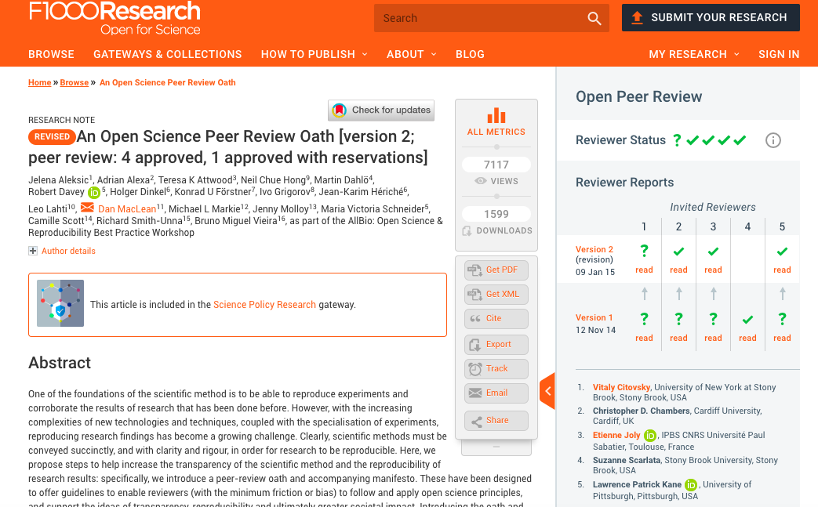
https://f1000research.com/articles/3-271

Slide 19
4. Only review for open access outlets and explain your decision to editors
Might convince editors to promote their journal as open access
However, the whole academic publishing system relies on voluntary peer review: more practical to take the previous steps?

Slide 21
Other ideas?

